Slide 1


Atliq Hardwares
Consumer Goods
Ad-hoc insights
SQL project challeng
Presented by Abdalmalik sawlan

Slide 2
Index
01
Background/context
03
Getting familiar with the input data
03
Our Mission and Vision
04
Solutions/result

Slide 3
Background / context
Our company
AtliqHardwares(imaginary company) -One of the leading computer hardware producers in India.
Background
The management noticed that they do not get enough insights to make quick and smart data-informed decisions.
Problem
There are 10 ad-hoc requests for which the company needs insights.
Approach
Run a SQL query to answer these requests.Convert it into visualizations and present the Insights to the top-level management.
02

Slide 4
Getting familiar with the input data
Atliq's product lines
PC
Personal laptop
P & A
Batteries
N &A
Desktop
Notebook
Processors
Peripherals
Accessories
Networking
Storag
Business laptop
Business laptop
Graphic card
Keyboard
SSD
Usb flash
Personal laptop
Wifi
extender
Gaming laptop
Internal HDD
MotherBoard
Mouse
02

Slide 5
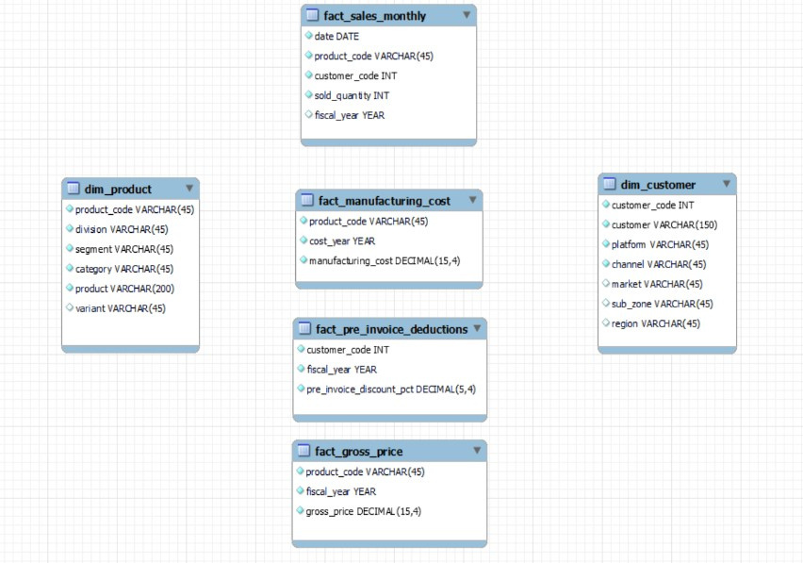
The data schema
• Input data consists of sales data for FY 2020 and FY 2021, along with different other dimension tables like customer details, product details, etc.

Slide 6
Our Mission
Objectives
Provide the list of markets in which customer "Atliq Exclusive" operates its business in the APAC region.
Objectives
What is the percentage of unique product increase in 2021 vs. 2020? The final output contains these fields,
Objectives
Provide a report with all the unique product counts for each segment and sort them in descending order of product counts. The final output contains 2 fields,
Objectives
Follow-up: Which segment had the most increase in unique products in 2021 vs 2020? The final output contains these fields,
Objectives
Get the products that have the highest and lowest manufacturing costs. The final output should contain these fields,
03

Slide 7
Our Mission
Objectives
Generate a report which contains the top 5 customers who received an average high pre_invoice_discount_pct for the fiscal year 2021 and in the Indian market. The final output contains these fields,
Objectives
Get the complete report of the Gross sales amount for the customer “Atliq Exclusive” for each month . This analysis helps to get an idea of low and high-performing months and take strategic decisions.
Objectives
In which quarter of 2020, got the maximum total_sold_quantity? The final output contains these fields sorted by the total_sold_quantity,
Objectives
Which channel helped to bring more gross sales in the fiscal year 2021 and the percentage of contribution? The final output contains these fields,
Objectives
Get the Top 3 products in each division that have a high total_sold_quantity in the fiscal_year 2021? The final output contains these fields,
03.1

Slide 8
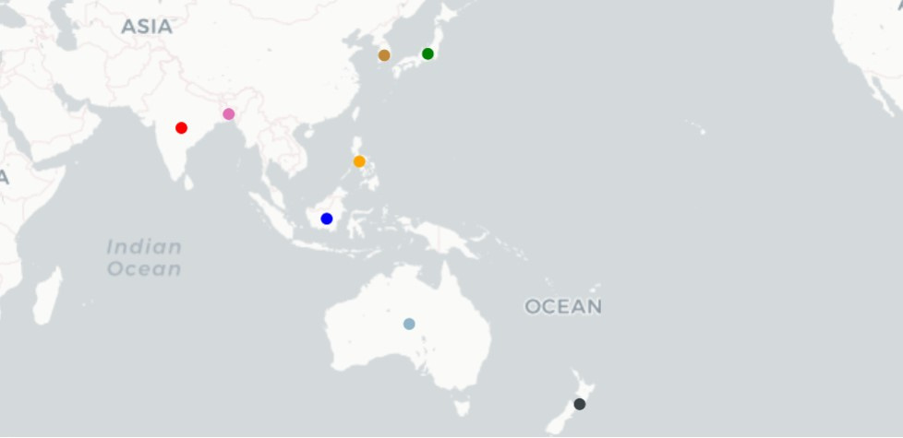
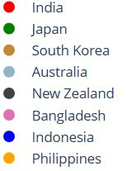
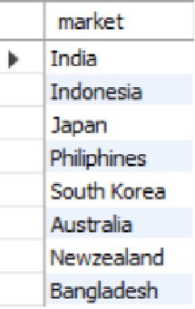
Provide the list of markets in which customer "Atliq Exclusive" operates its business in the APAC region.
Output
In this requirement, all branches that the company has in the continent of Asia and Australia are displayed
0.4

Slide 9
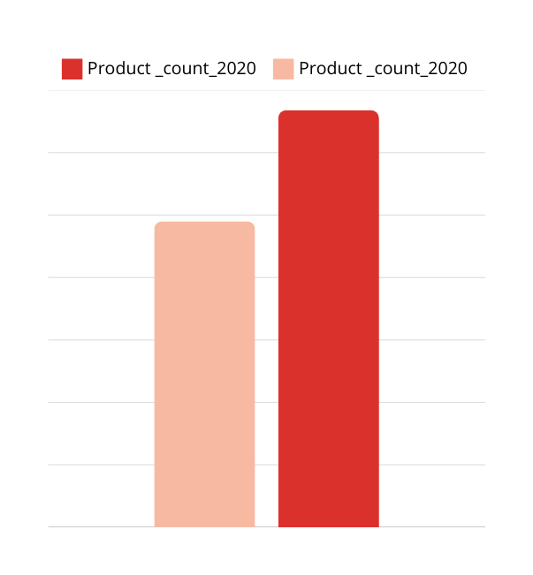

What is the percentage of unique product increase in 2021 vs. 2020? The final output contains these fields,
In this chart, we see the number of products in the year 2020 and the number in 2021. It also appears that more new products were launched to the market in the year 2021, an increase of approximately 36%, which is considered a good sign.
334
245
36.33
% increase
Output
2020
2021
0.4.1

Slide 10

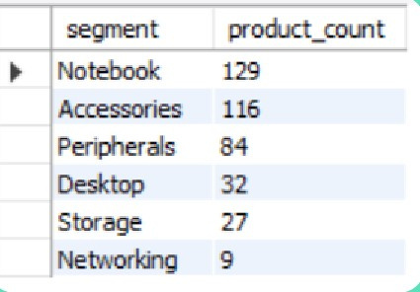
Provide a report with all the unique product counts for each segment and sort them in descending order of product counts. The final output contains 2 fields,
How many products are there in each segments?
Output
129
116
84
32
27
9
Notebook
Accessories
Peripherals
Desktop
Storage
Networking
0.4.2

Slide 11

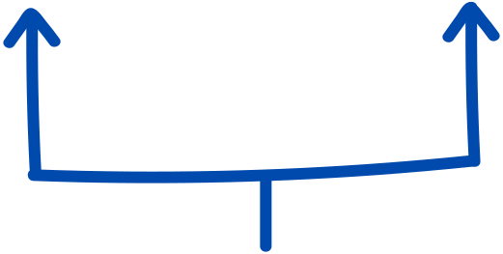
Follow-up: Which segment had the most increase in unique products in 2021 vs 2020? The final output contains these fields,
segment | product_count_2020 | product_count_2021 | defrent
Notebook | 69 | 103 | 34
Accessories | 92 | 108 | 16
Peripherals | 59 | 75 | 16
Desktop | 7 | 22 | 15
Storage | 12 | 17 | 5
Networking | 6 | 9 | 3
incrace 34 products
Storage and networking are experiencing slower production growth than
other segments.
0.4.3

Slide 12
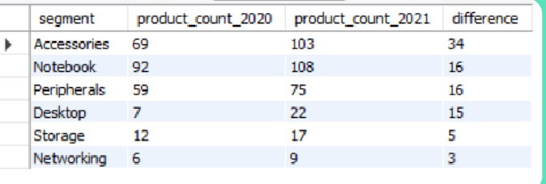
Output
We have increased strength and increase in connections, so that in the year 34 a new type of connectors has increased, and we must focus on networks that are the least expensive type of product.
0.4.4

Slide 13


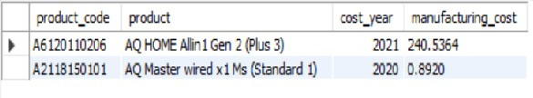
Get the products that have the highest and lowest manufacturing costs. The final output should contain these fields,
$240.54
$0.89
product having the highst and lowest manufacutring cost
AQ Master wired x1 Ms (Standard 1
AQ HOME Allin1 Gen 2 (Plus 3)
Personal Desktop
Mouse
0.4.5

Slide 14

Generate a report which contains the top 5 customers who received an average high pre_invoice_discount_pct for the fiscal year 2021 and in the Indian market. The final output contains these fields,
In 2021, we offered nearly equal pre percentages to each of invoice discount our top 5 customers, given that Flipkart is the most discounted customer in the Indian market, which equals 30.83%.
30.83%
30.38%
30.28%
30.25%
29.33%
Peripherals
Peripherals
Peripherals
Peripherals
Peripherals
0.4.6

Slide 15
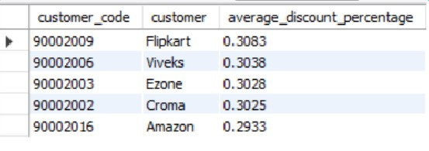
Output
0.4.7

Slide 16

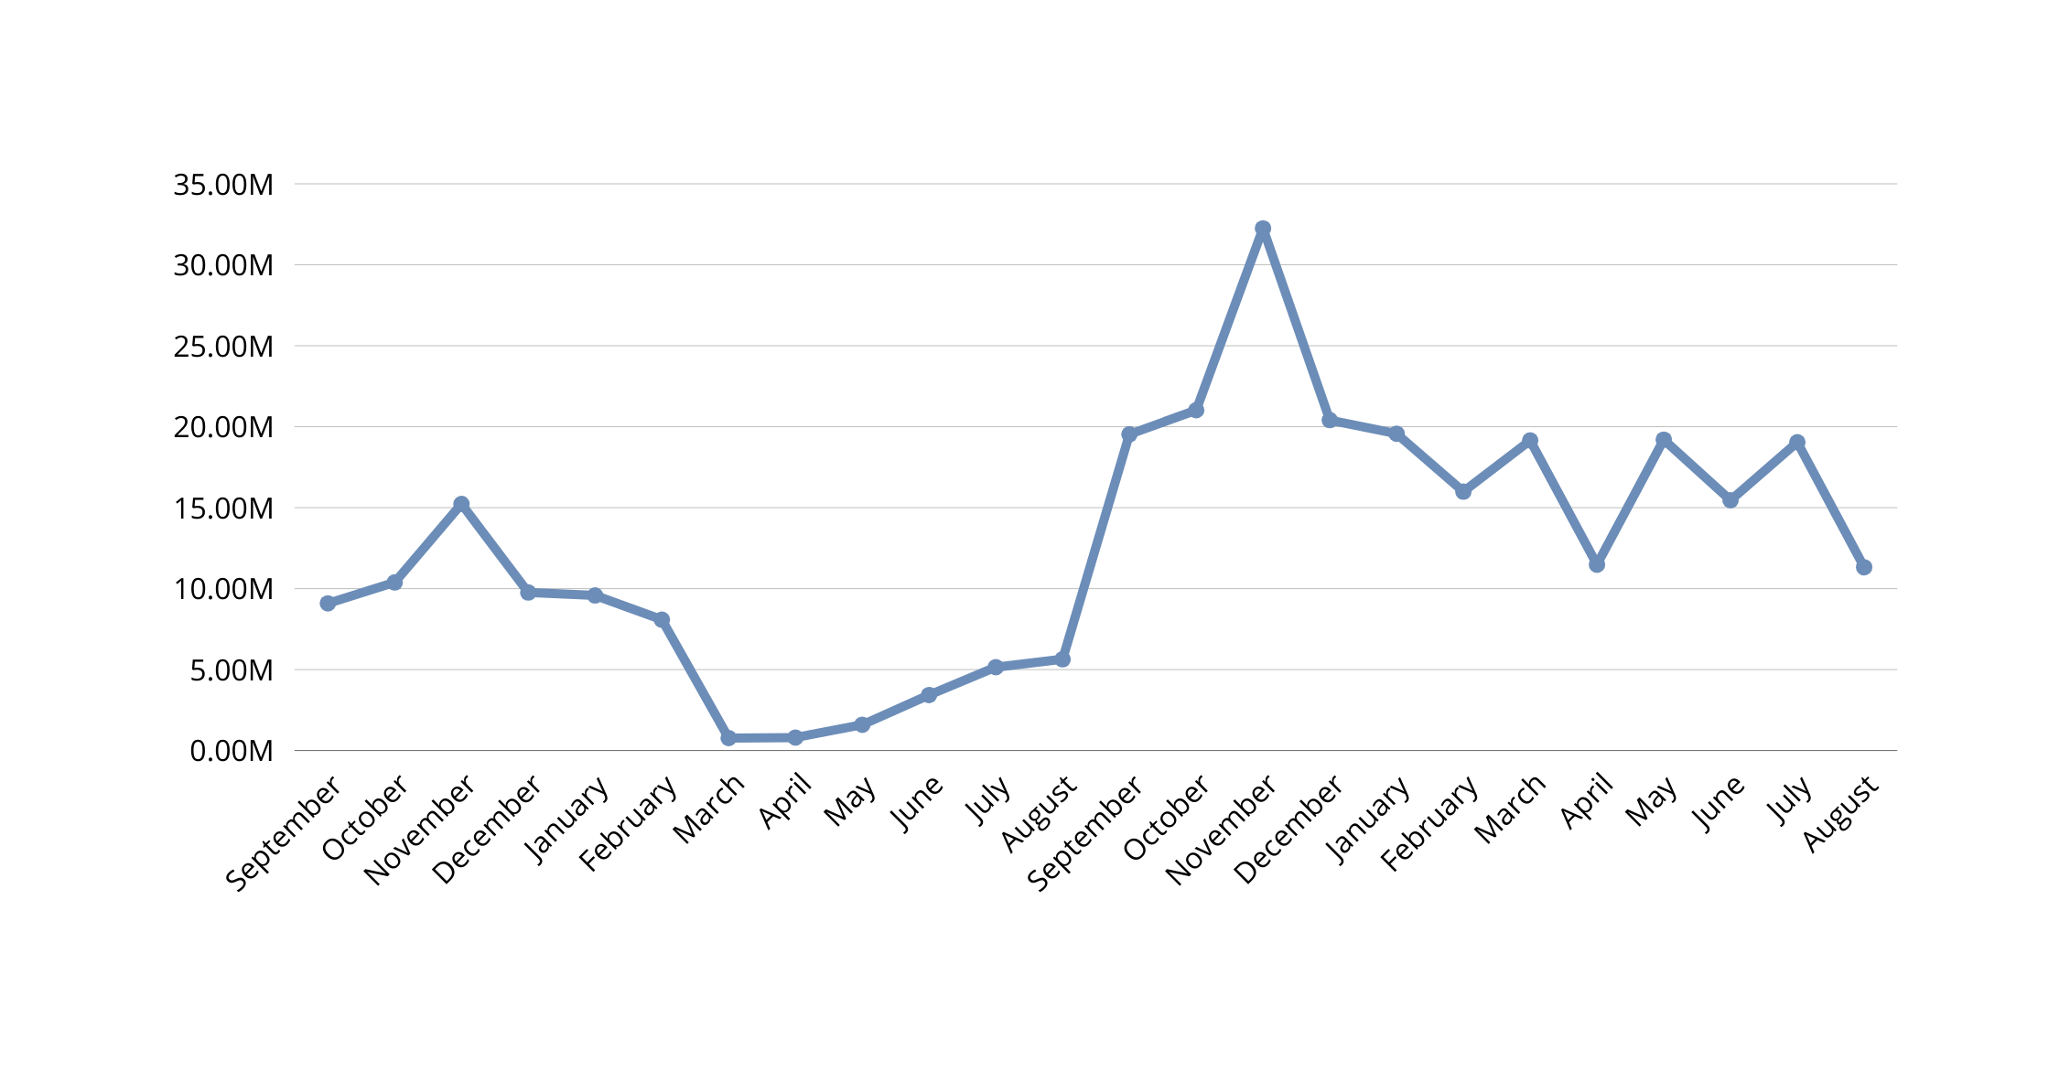

Get the complete report of the Gross sales amount for the customer “Atliq Exclusive” for each month . This analysis helps to get an idea of low and high-performing months and take strategic decisions.
32.25M
2019
2020
2021
0.77M
0.4.8

Slide 17
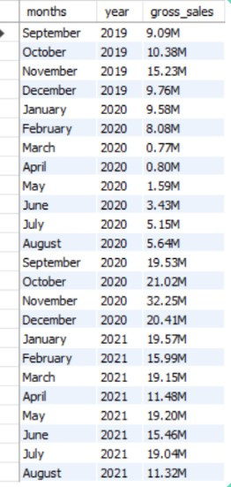

Output
For Atliq Exclusive, November 2020 marked the highest sales, and March 2020 marked the lowest gross sales. It’s very evident that the lower sales between March and August are because of COVID-19. However, it’s a very good sign that the sales increased quickly after Insights August and reached the highest level since the last two years in Novembe
0.4.9

Slide 18
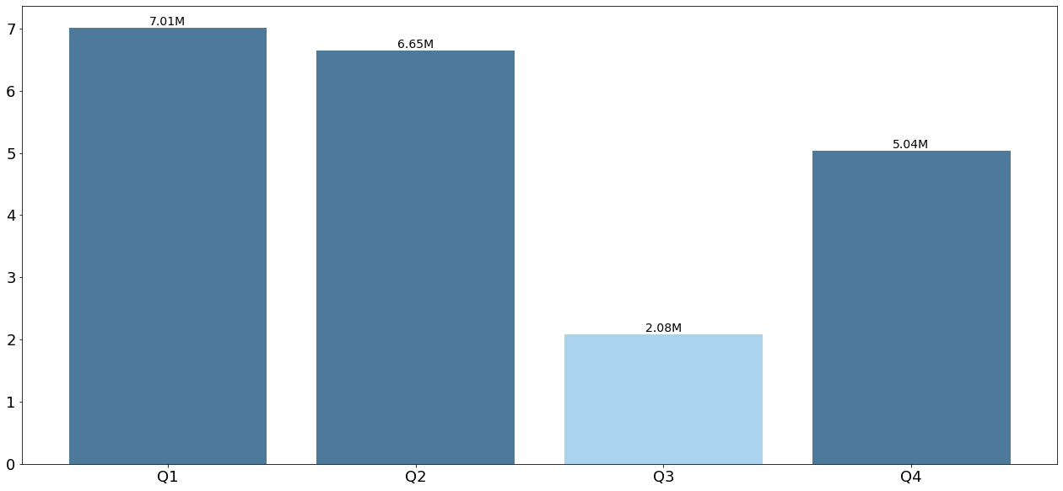

In which quarter of 2020, got the maximum total_sold_quantity? The final output contains these fields sorted by the total_sold_quantity,
This is the lowest quarter of sales in 2020
0.5

Slide 19
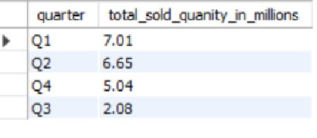
Output
This 19 was at its peak . early recovery during quarter 4 is probably because of the increased need for hardware like desktops and notebooks as majority of the students began or continued to do their coursework online during this time , and there was a huge demand for computer accessories during this period. C
The sold quantity decreased to 2.1 million in quarter 3 of FY 2020, which was actually March, April, and May when COVID This 19 was at its peak .
0.5.1

Slide 20
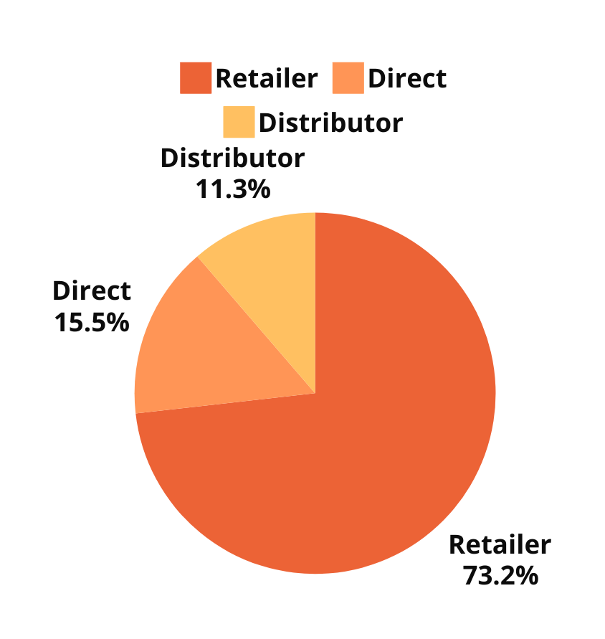
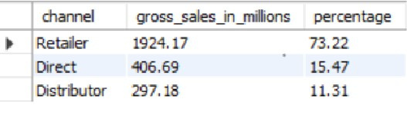
Which channel helped to bring more gross sales in the fiscal year 2021 and the percentage of contribution? The final output contains these fields,
Output
The majority of our sales took place via retailers, which is 75% of the total sales. Only a very small percentage of our sales happened through direct and distributor channels
0.5.2

Slide 21



Get the Top 3 products in each division that have a high total_sold_quantity in the fiscal_year 2021? The final output contains these fields,
Division:N & S
Division:P & A
Division:PC
1
2
3
1
2
3
1
2
3
AQ Pen Drive 2 IN 1(Premium)
AQ Pen Drive DRC(Plus)
AQ Pen Drive DRC(Premium)
AQ Gamers Ms(Standard 2)
AQ Maxima Ms(Standard 1)
AQ Maxima Ms(Plus 2)
AQ Digit(Standard Blue)
AQ Velocity(Plus Red)
AQ Digit(Premium Misty Green)
0.5.3

Slide 22
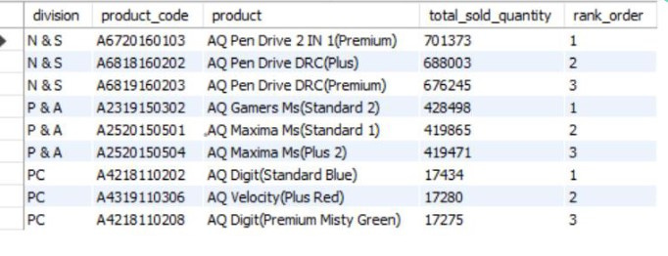
OUTPUT
Every division has a product with differentvariants that appears twice in the top three products by division list
0.5.4

Slide 23
Thank you for your time

